Slide 1
Battle of Neighbourhoods- Chasing Localities with best foods!

Slide 2
Introduction
Mumbai, a city located on the shore of Arabian Sea, on the western coast of India, is one of the most populous cities in the world. The project helps in finding out the localities in Mumbai, India having the best food places. The project helps in analyzing the which localities has the best cuisines. Also, providing information about ratings given to these restaurants by diners. Being a multicultural city, the city has wide variety of traditional Indian as well as International Cuisines. At the end of the project, we would be able to answer several questions like What is the best locality for traditional Indian cuisines? Localities with highest rated restaurants Which areas have lowest number of restaurants?
Gaining insights from this data, anyone who wants to set up his new business in this field can check for its feasibility. They can decide upon the localities where they want to come up and cuisines they would like to offer.

Slide 3
Can help explore and answer questions like:
What is best location in Mumbai for North Indian Cuisine ?
Which areas have large number of restaurants ?
Which all areas have less number of restaurants ?
Which is the best place to stay if I prefer South Indian Cuisine ?
What places are have best restaurant in Mumbai?

Slide 4
Approach
Collect the Mumbai city data from Zomato kaggel dataset
Using Foursquare API we will find all venues for each neighborhood.
Filter out all venues that are nearby by locality.
Using aggregative rating for each restaurant to find the best places.
Visualize the Ranking of neighborhoods using folium library(python)

Slide 5
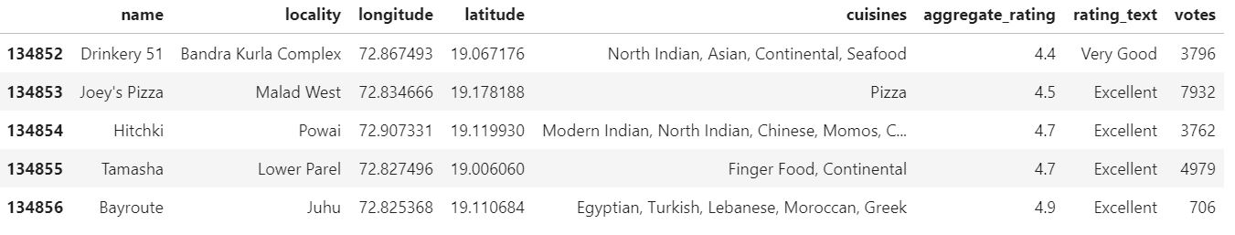
Data
Zomato Dataset
This Zomato exploratory data analysis is for the foodies to find best restaurants, value for money restaurants in their locality. It also helps to find their required cuisines in their locality. The data is collected using Zomato API. The extraction process involves two steps. In first step the city IDs of all the Zomato available cities in India are stored using Zomato "/cities" API. In the second step using these city IDs, restaurant details in the respective cities are stored in comma separated file (csv). The dataset is quite rich with details of 100k+ restaurants like locality, ratings, types of cuisine available.

Slide 6
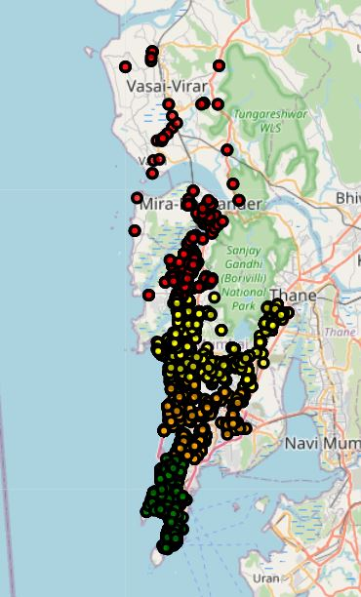
Cluster based map

Slide 7
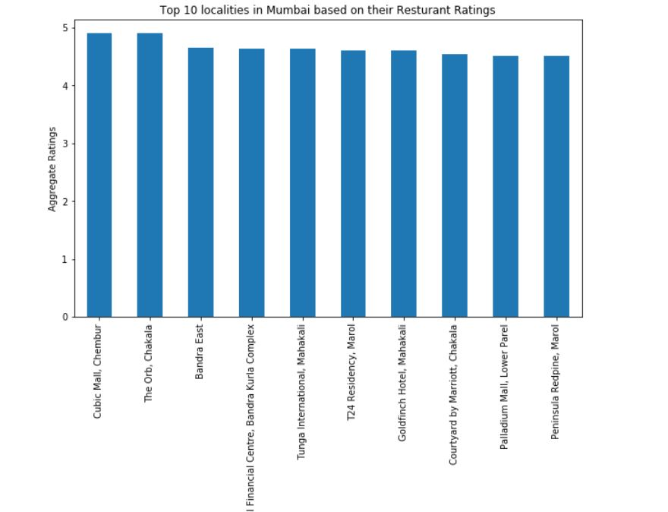
Cubic Mall in Chembur has the highest rated restaurants

Slide 8
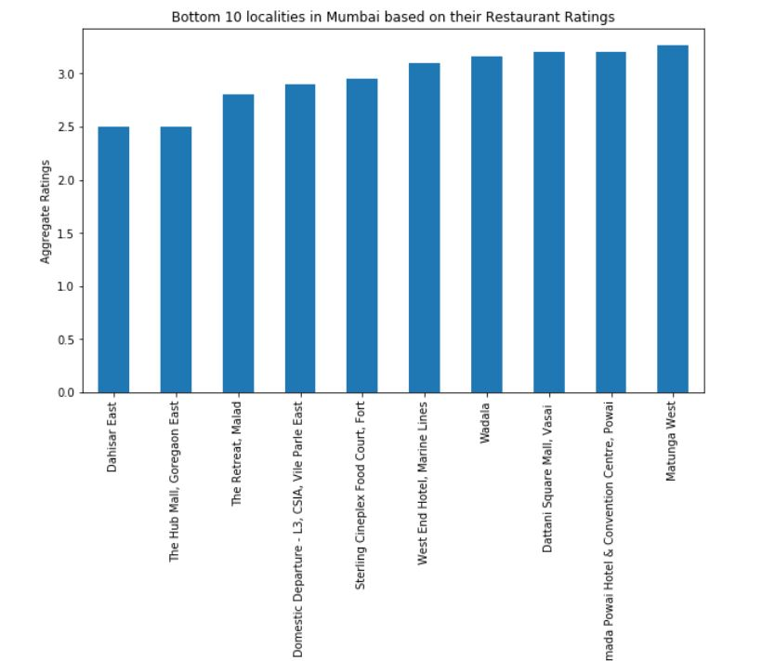
Dahisar East is the locality with lowest rated restaurants.

Slide 9
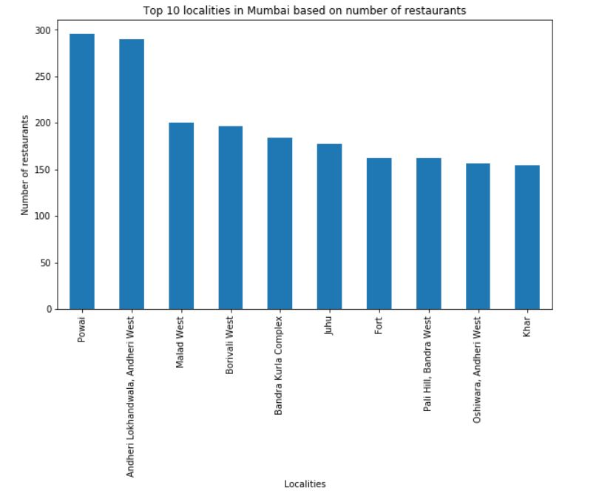
Powai has the highest number of restaurants in Mumbai

Slide 10
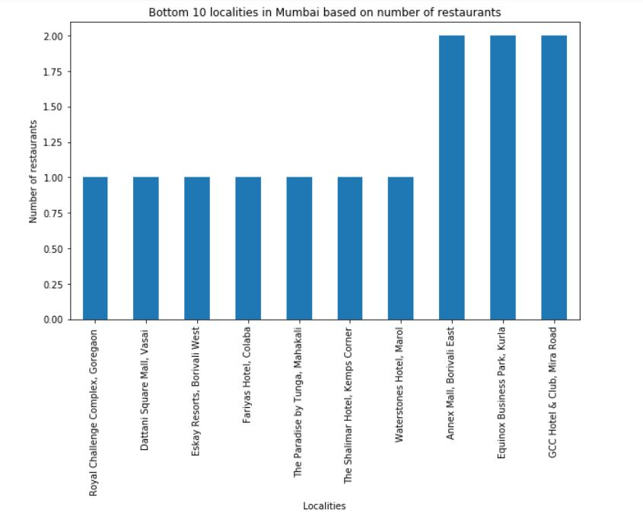

Slide 11
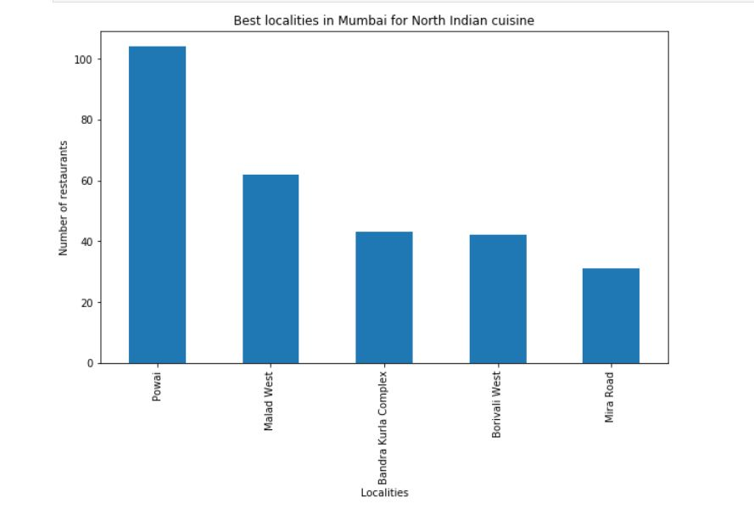
Powai has the highest number of restaurants offering North Indian Cuisine

Slide 12
Conclusions
Powai has the highest number of restaurants in Mumbai.
Dahisar has lowest number of restarants.
Chembur has the highest rated restaurants in Mumbai.
Powai has the restaurants offering best North Indian Cuisine

